Slide 1
Workshop : How to teach student using IT
Made by Hassan qamar (bscs from the university of Karachi)

Slide 2
Who is the best Teacher you can ever said?
?

Slide 3
Hazrat Muhammad (S.A.W)
You know the incident of taif.
You know the condition of people of Arab before Islam.
You should know how our Nabi (S.A.W) taught us
We should follow them and inshaAllah Succeed.

Slide 4
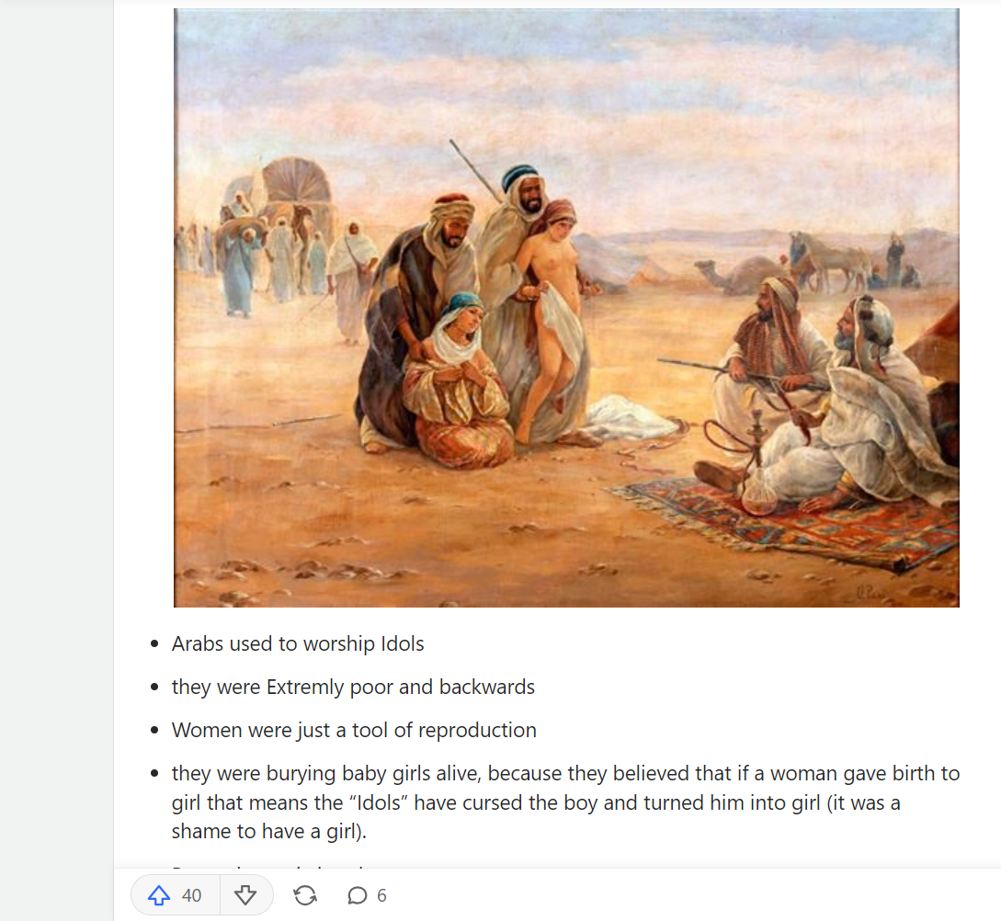
The Era of Jahiliya before Islam :
The Jahiliya

Slide 5
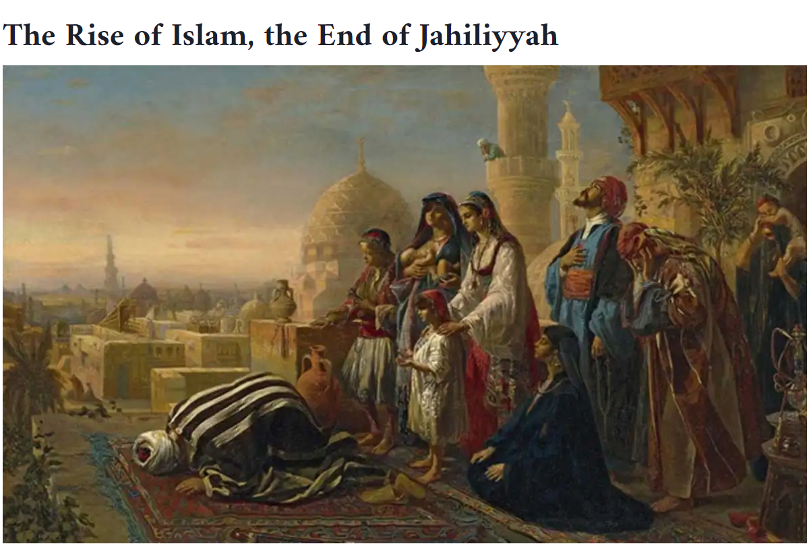
After Islam:
The End of Jahiliya

Slide 6
What to teach?
Discipline, Discipline, Discipline
Punctuation
What is your Journey.

Slide 7
How to teach student in 2023
As you know this is the era of It and every hand have Smart Mobile Phones.
How you learn share your experience.
What to do to make class interactive.
This all with the help of technology and teacher’s collaboration.

Slide 8
The downfall of my people.
Cheating(Sifarish)
Lack of Justice

Slide 9
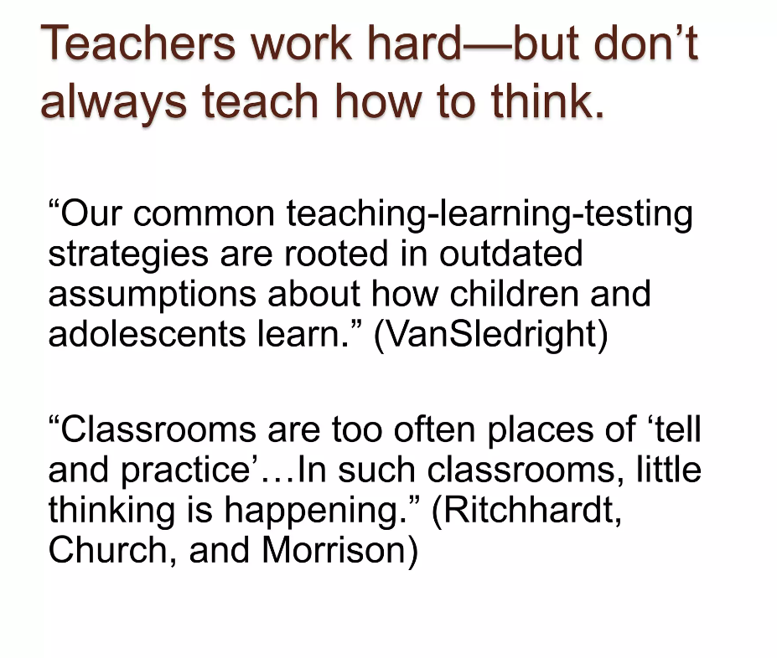
Teaching is not a job it is an Art.

Slide 10
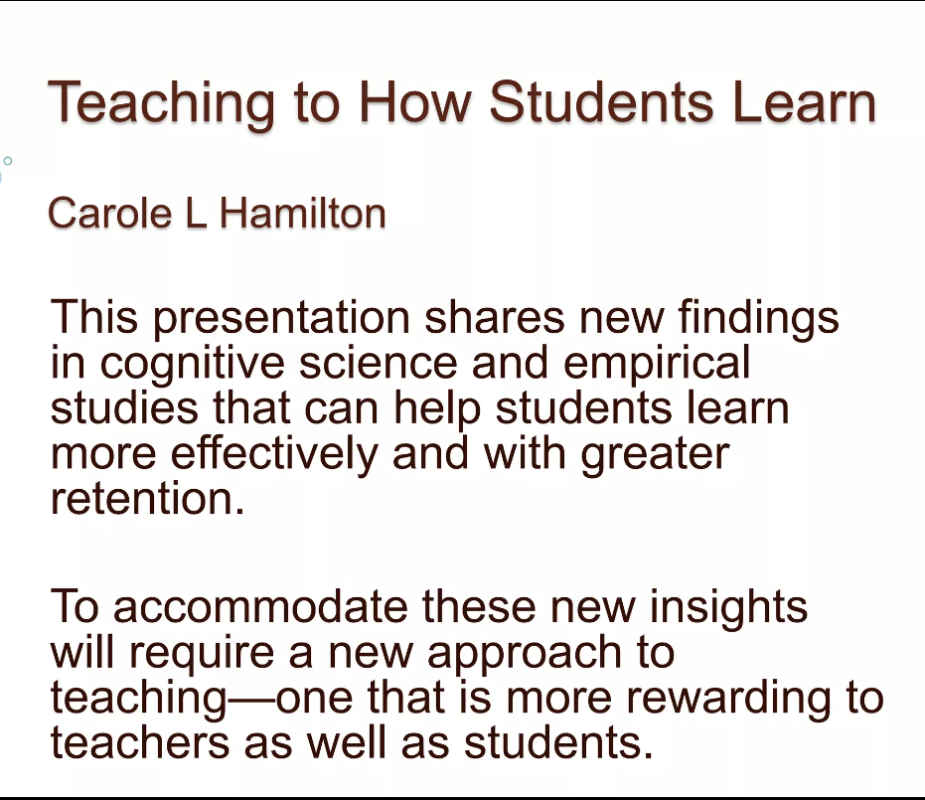
Teaching is not a job it is an Art.

Slide 11
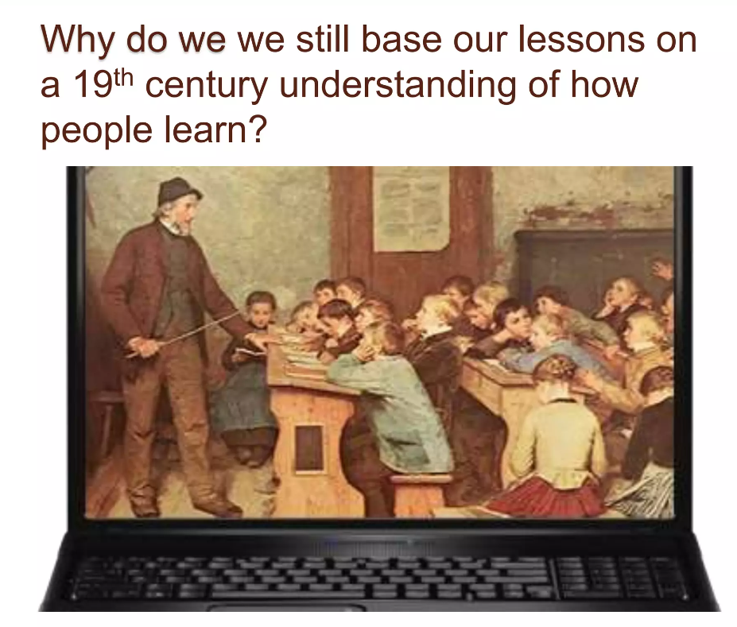
Teaching is not a job it is an Art.

Slide 12
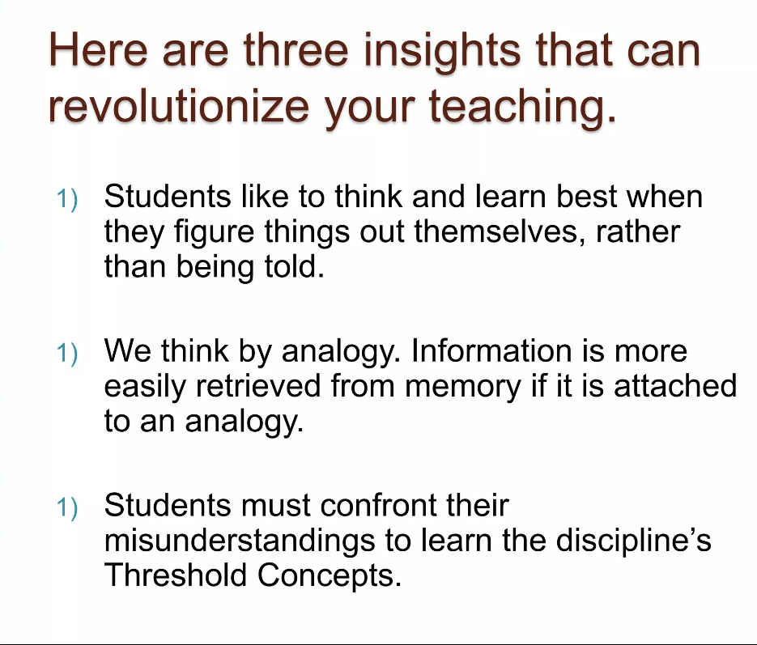
Teaching is not a job it is an Art.

Slide 13
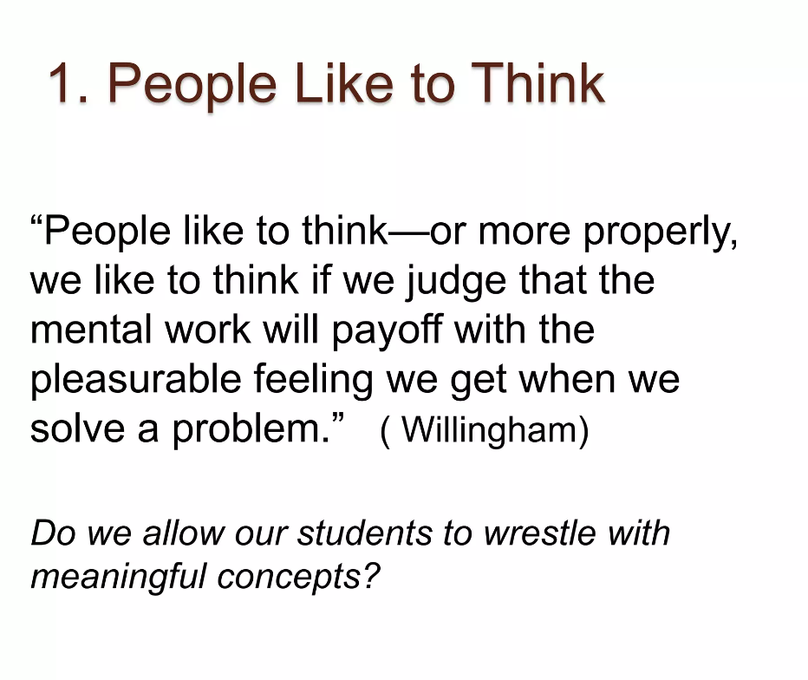
Teaching is not a job it is an Art.

Slide 14
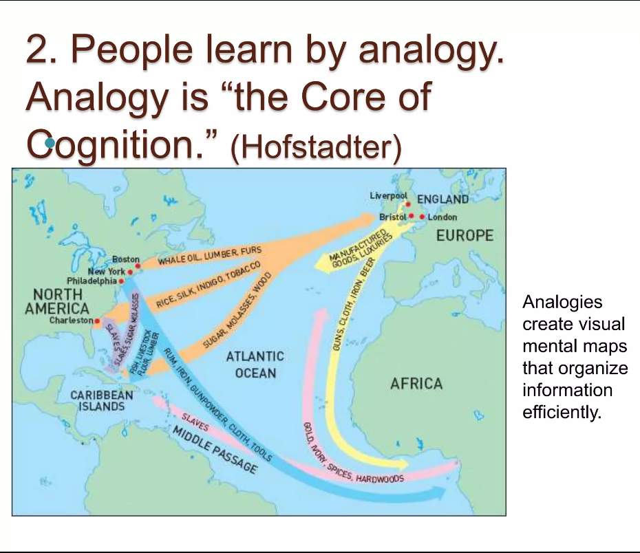
Teaching is not a job it is an Art.

Slide 15
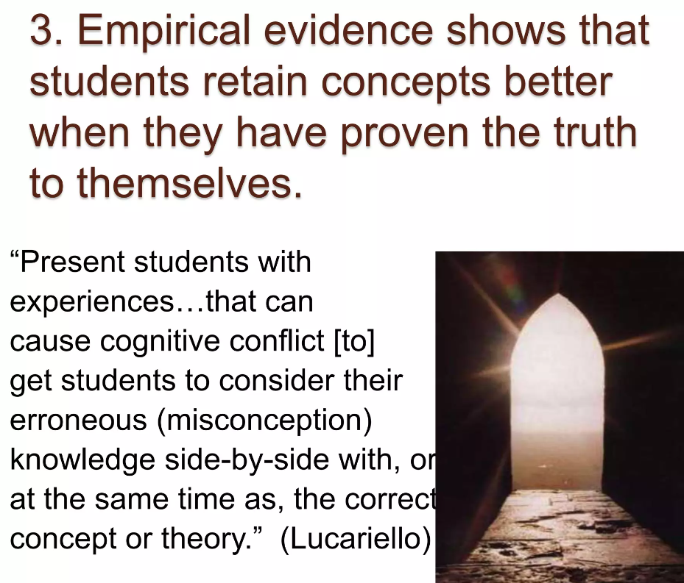
Teaching is not a job it is an Art.

Slide 16
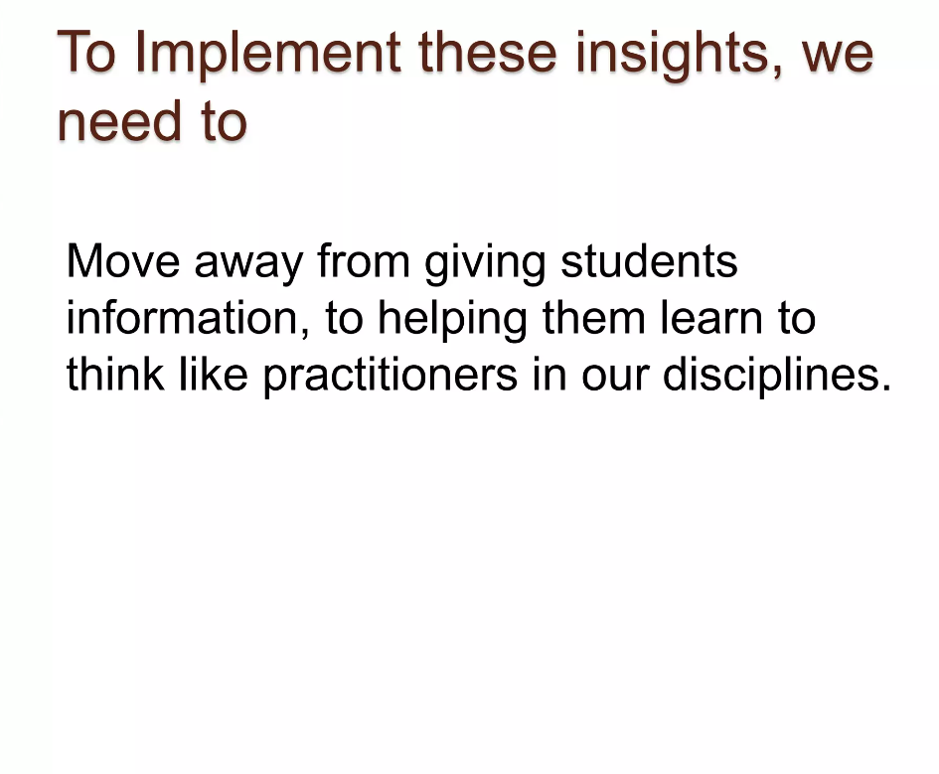
Teaching is not a job it is an Art.

Slide 17
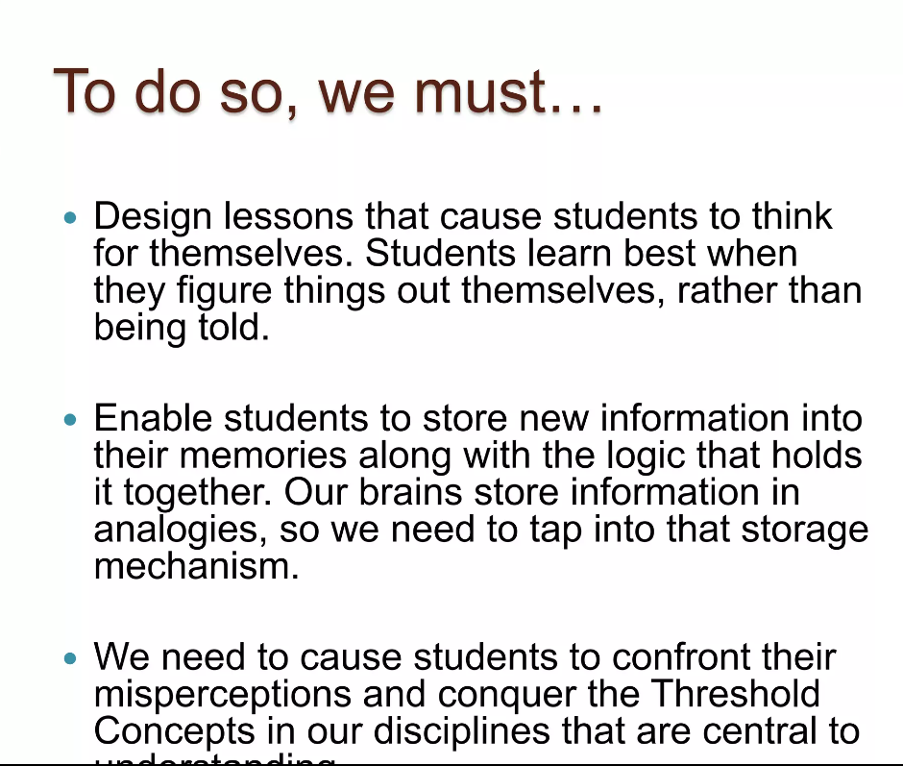
Teaching is not a job it is an Art.

Slide 18
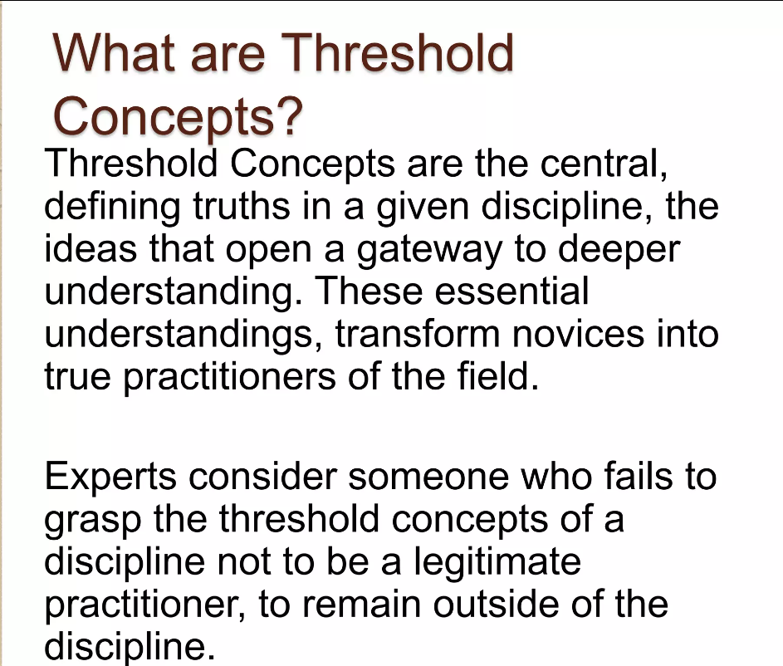
Teaching is not a job it is an Art.

Slide 19
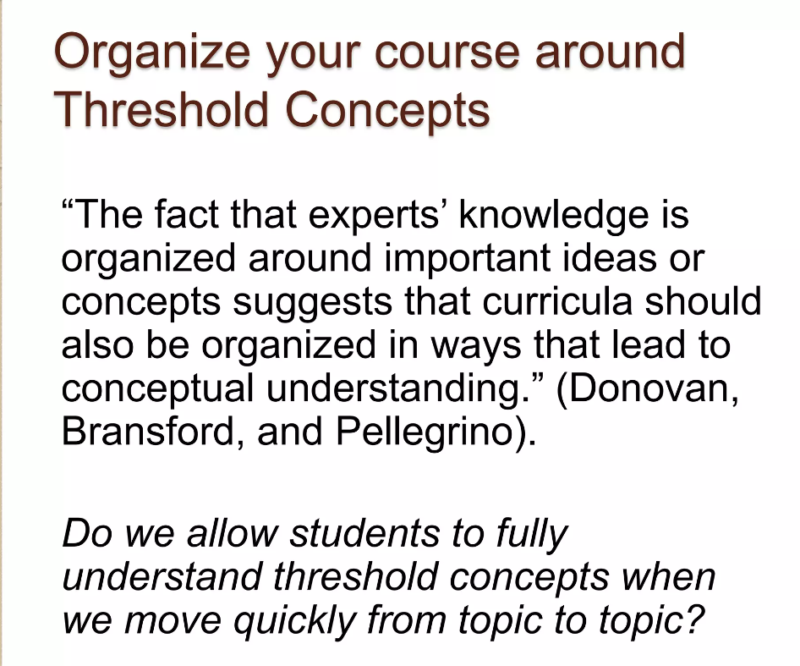
Teaching is not a job it is an Art.

Slide 20
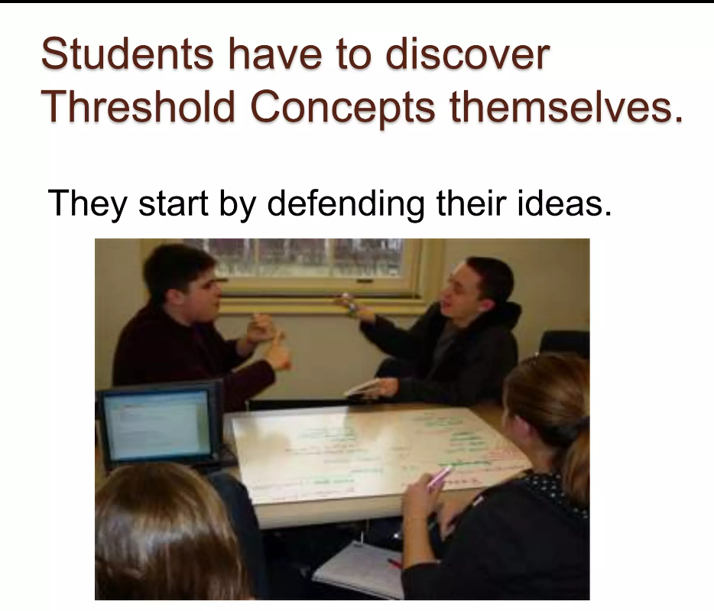
Teaching is not a job it is an Art.

Slide 21
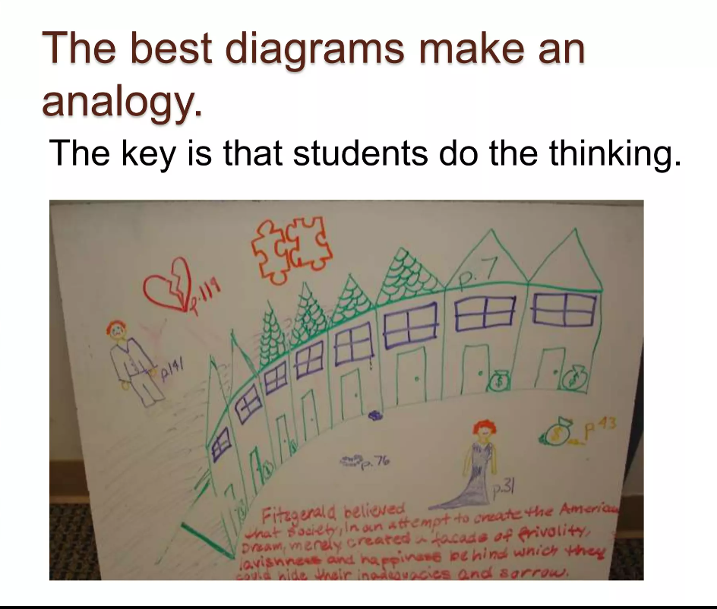
Teaching is not a job it is an Art.

Slide 22
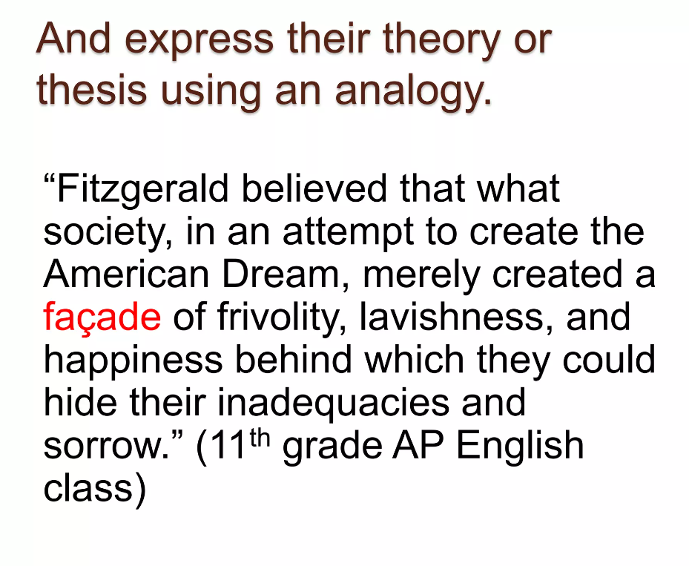
Teaching is not a job it is an Art.

Slide 23
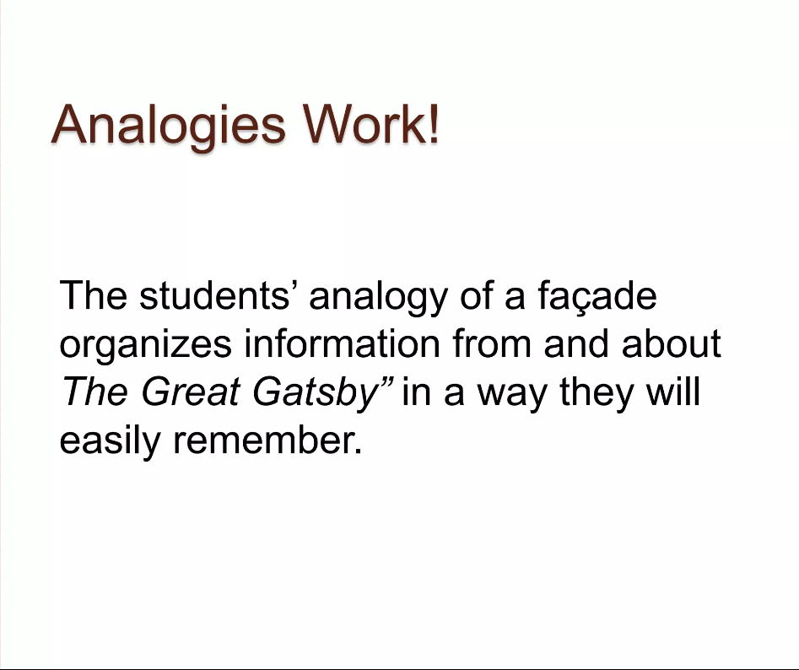
Teaching is not a job it is an Art.

Slide 24
Using IT
Multimedia
ChatGPT
Google AI tools

Slide 25
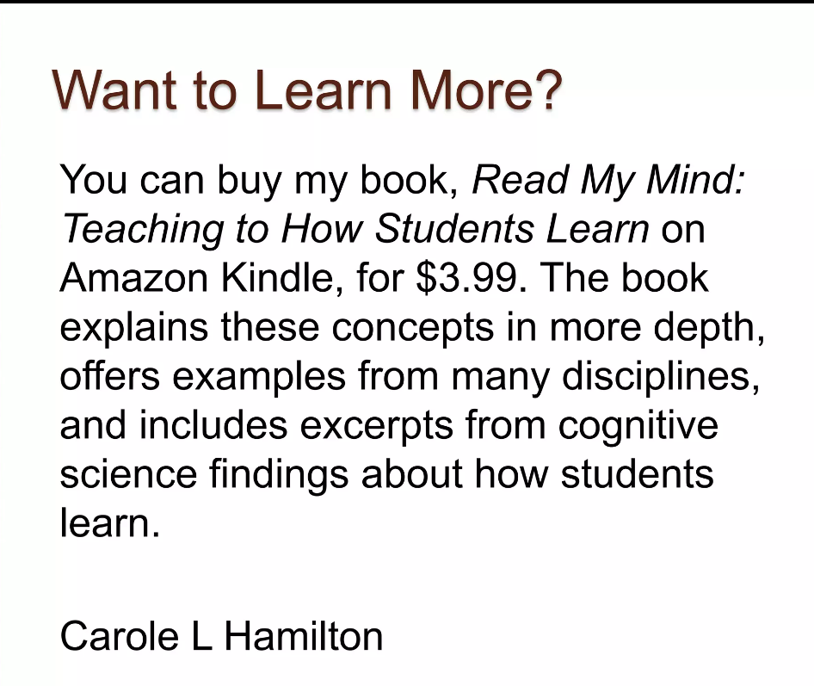
Teaching is not a job it is an Art.

Slide 26
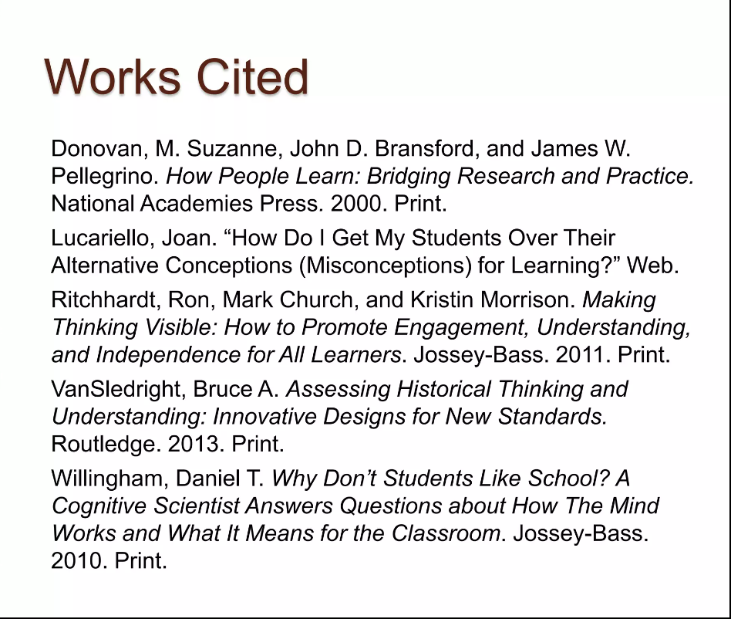
Teaching is not a job it is an Art.

Slide 27
That’s all:
Thank You
Any Question

Slide 28
Made by:
HASSAN QAMAR

